Slide 1






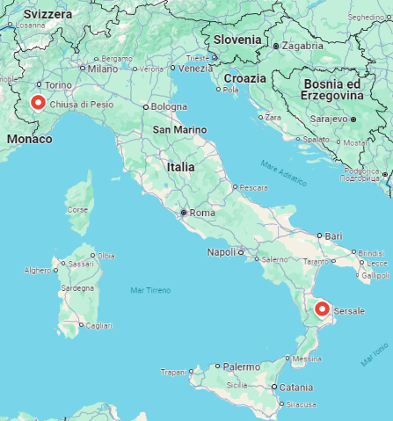
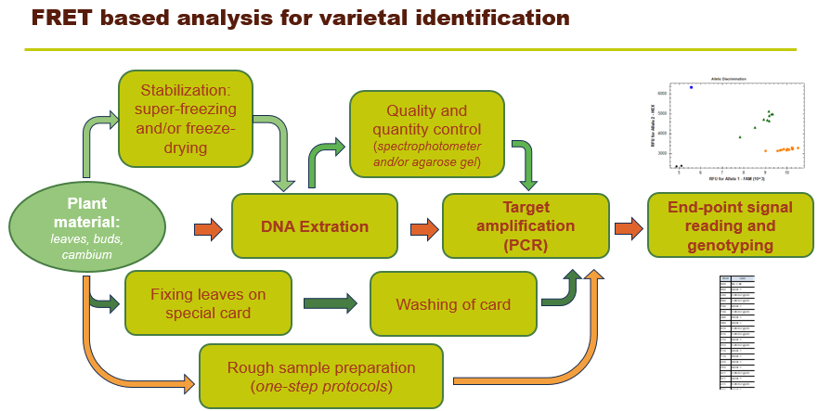
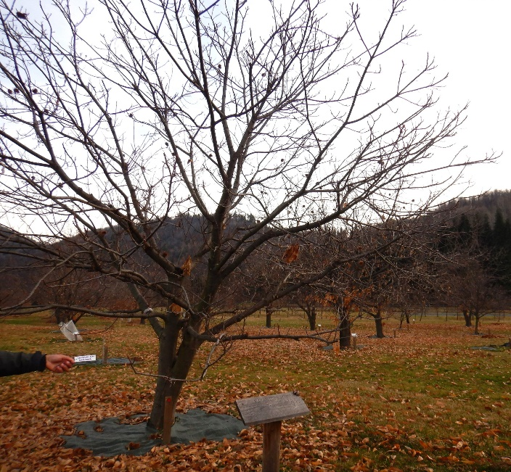
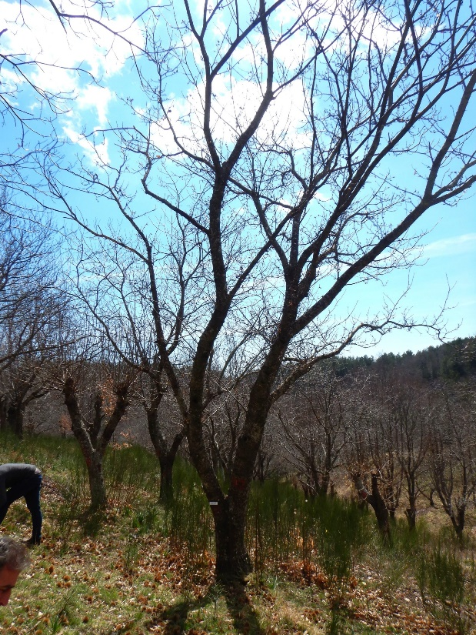
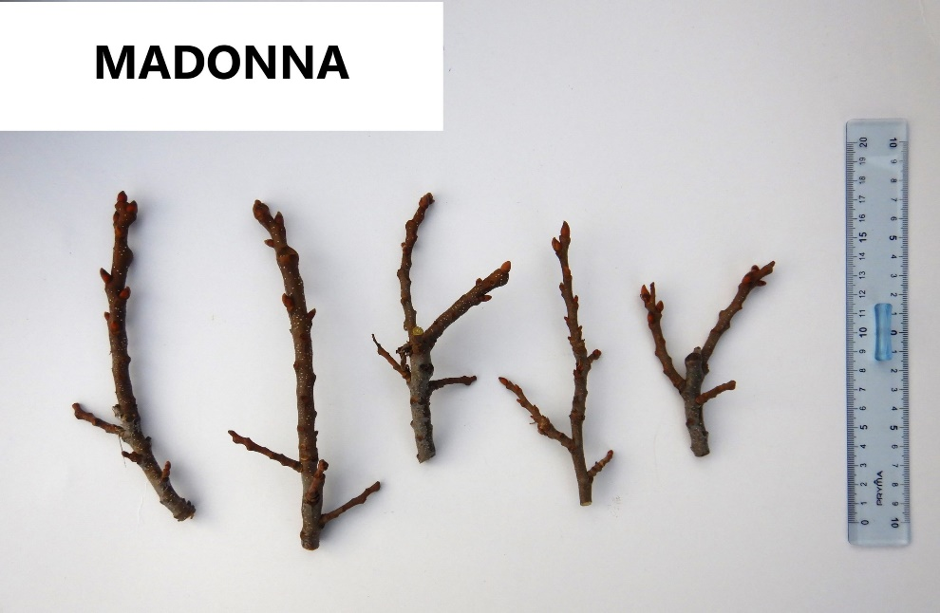
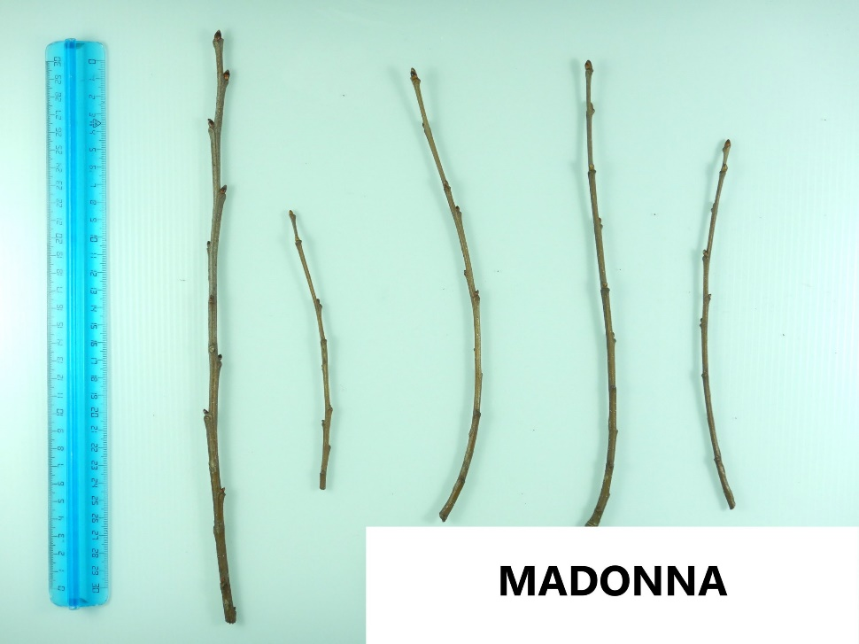
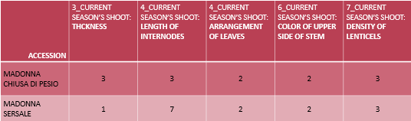
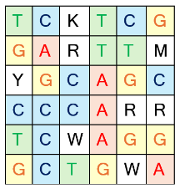
7.13 DNA fingerprinting of chestnut cultivars: enhancing resources and tools for plant material traceability
D’AGOSTINO N.¹, PASSARO S. ², VICIGRADO F. ², GENTILE D. ², FRUGGIERO I.¹, MAISTO A.¹,NUNZIATA A.²
Department of Agriculture, University of study of Naples Federico II, 80055 Portici (NA), Italy
Research Center for Olive, Fruit and Citrus Crop, CREA, 81100 Caserta (CE), Italy
BACKGROUND
Over the past decade, there has been a renewed interest in the chestnut supply chain, leading to numerous initiatives aimed at conserving and exploiting the biodiversity of this valuable crop. Genetic fingerprinting has become an essential tool for identifying both new and traditional chestnut varieties, managing nursery plant materials, and protecting plant breeders' rights. Currently, a range of molecular markers with varying levels of complexity, information content, and cost are available for chestnut varietal identification. The CASTARRAY project has underscored that Kompetitive Allele-Specific PCR (KASP) analysis, utilizing a panel of 37 SNPs, is a practical and cost-effective approach for distinguishing between different chestnut varieties.
* Task 1.4: detection of genetic fingerprints for reorganization, traceability and varietal certification
An effective contribute to the re-organization of the Italian chestnut germplasm is being released by CREA thank to the use of conventional genetic fingerprints
** Traceability of chestnut cultivars using KASP technology for genetic fingerprinting
The KASTRACK project is going to trasfer a method for chestnut fingerprinting to private laboratories
RESULTS
To date 213 accessions were sampled from two major Italian biodiversity fields
The KASTRACK group is developing specialized protocols for the filed collection of vegetative tissues, with subsequent analysis thorough direct Polymerase Chain Reaction (dPCR) or DNA isolation. We are also testing these protocols across various thermocyclers to optimize their efficiency and reliability.
Chiusa di Pesio (CN) managed by
“Chestnut RD Piemonte”
Sersale
(CZ)
managed by
“ARSAC Calabria”
DNA fingerprints are stored in a dedicated database that also incorporates discriminating morphological traits. Users can query the database through three distinct modes:
Discriminating accessions by SNPs and/or morphological traits: By selecting one or more SNPs and/or phenotypic traits, users can retrieve a list of accessions that meet the specified criteria. The results highlight SNP markers with the highest Polymorphism Information Content (PIC) values. This mode is particularly useful for accurately distinguishing varieties based on available genetic and/or morphological data.
Identifying most discriminative SNPs: This tool helps identify the SNPs that are most effective in distinguishing between recorded accessions. By selecting an accession, the platform provides a list of the minimum number of SNPs and associated alleles that are most effective for its discrimination and characterization. This feature is especially valuable for developing specific KASP (Kompetitive Allele Specific PCR) protocols.
Searching user-defined genotype strings: Users can input genotype strings (concatenated list of SNP Loci ordered by chromosome and position) to calculate the genetic distance between new accessions and those already genotyped. This function aids in the identification and classification of new varieties by comparing their genetic profiles with existing data.
These query options provide a comprehensive framework for analyzing and comparing chestnut varieties/accessions.
The results revealed the presence of 150 genotypes which are now being meticulously documented in detailed sheets
Add SNP
Current season's shoot: Thickness
Thin
Medium
Thick
Current season's shoot: Color of upper side of stem
Yellow-brown
Brown
Red-brown
Current season's shoot: Density of lenticels
Sparse
Medium
Dense
SELECTION
Top pic number:
SELECTION
SUBMIT
Among the sampled cultivars, several produced identical genetic profiles, suggesting that while they may not be completely identical, they likely originate from the ancient propagation of a single, highly valued tree.
Over time, these clones have accumulated agronomically relevant mutations, or the minor morphological differences observed could be attributed to varying environmental conditions in which they grow.
To further investigate these seemingly identical accessions, specific subsets have been selected to idnetify new SNPs with different allelic configurations in particular clones. This effort aims to assess the utility of these SNPs in distinguishing clonal varieties.
CULTIVAR SELECTION:
SELECTION
Find discriminant SNP
Partial string identical to: CULTIVAR 3
www.valoreincampo.crea.gov.it
www.kastrack.crea.gov.it
SUMMARY AND PROSPECTS
Data and optimized protocols for the rapid and cost-effective identification of chestnut cultivar are available. By making this methodology accessible to private laboratories, stakeholders can leverage this tool for various applications. To maximize its impact, we are actively sharing knowledge with all potential end-users, including agricultural companies, nurseries, processing companies, and public bodies. This dissemination effort aims to empower these groups to seize significant opportunities in sustainable chestnut cultivation, such as varietal diversification and the preservation of agro-biodiversity.
DM 667521 del 30/12/2022; CUP J53C23000450001
** DICA PG/2024/0071218 del 08/02/2024; CUP B59H23000040006

